Slide 1
Rock, Paper, Scissors Final Presentation
By:
Corey Merritt
&
Jackson Hay

Slide 2
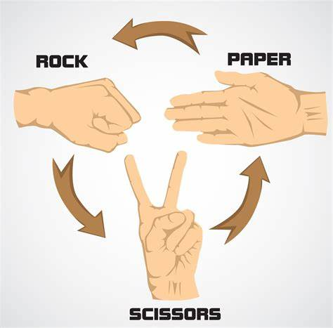
Agenda
Agenda
Introduction
Problem/Statement Objective
Project Flow
Project Flow continued
Project Flow continued
Results/Output
Live Demonstration
Discussion
Thank You !

Slide 3
Introduction
We created the game Rock, Paper, Scissors using python
We used input to receive the user's choice
We used a random function to receive computers choice
We then used an if statement to compare the results and then it would add a point to the winner’s score
Finally, we added an input statement to allow the user to play again until they said no then we used a break to end the game and it would display a message that says thanks for playing

Slide 4

Problem statement/ Objective
Our goal is to make a highly interactive game of Rock, Paper, Scissors that implements core programming concepts such as loops, functions, classes, and user input.
The primary objective is to create an engaging gaming experience for users while demonstrating proficiency in Python programming fundamentals

Slide 5
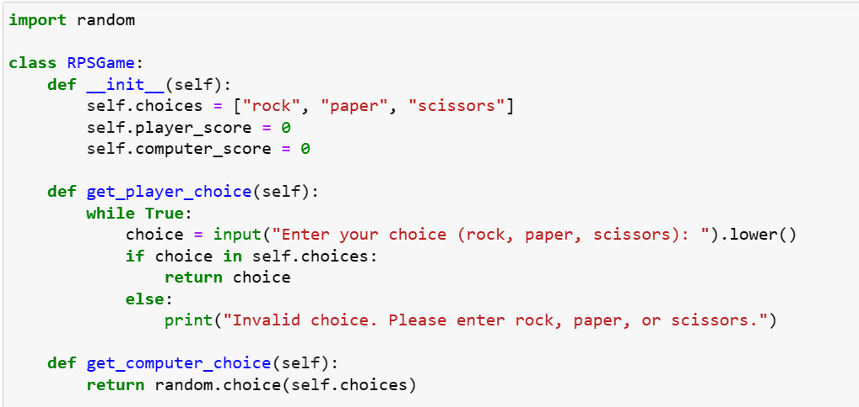
Project Flow- High level

Slide 6
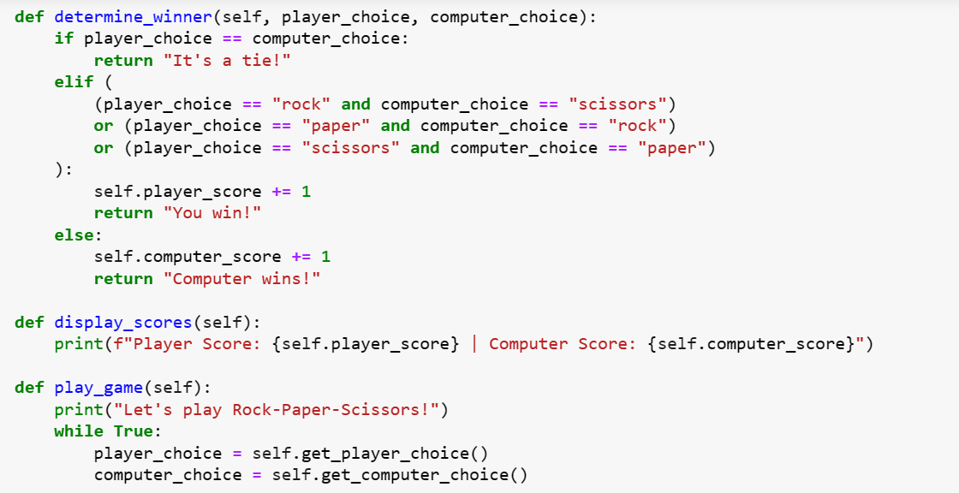
Project Flow- High level (cont.)

Slide 7
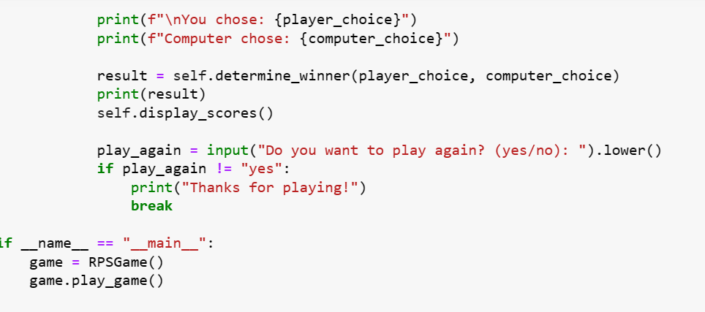
Project Flow- High Level Continued

Slide 8
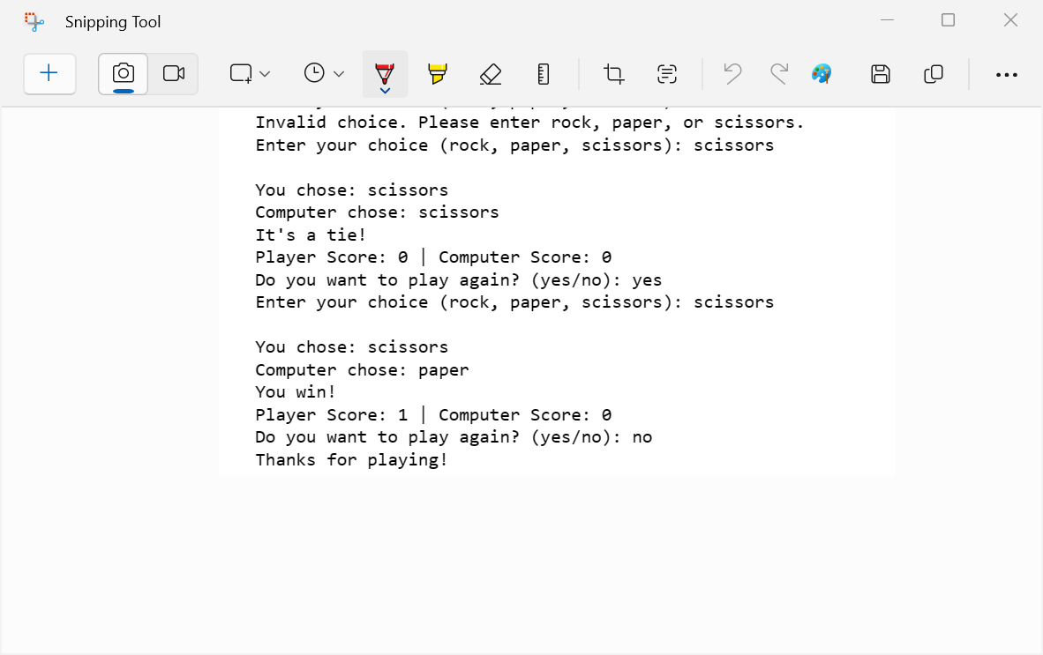
Results/ Output

Slide 9
Working principle- Demo
Final_Project - Jupyter Notebook

Slide 10

Discussion

Slide 11
Thank You

